Slide 1
Containers
8th Aug 2019

Slide 2
Shell scripting
Revised shell scripting concepts earlier this week
Demo (address book for cricketers)
Add data (25 points)
Name, team, batting average
If the name is duplicating a name already in the address book, prompt to replace old information with new
Search (25 points)
By name or team
Display all relevant records
Remove (25 points)
After search returns a record, offer the option to remove it
Scrape (25 points)
Scrape current Indian ODI players’ records from Cricinfo and populate the address book

Slide 3
Logistics for next week
Monday is a holiday
Make-up lab on Tuesday?
Thursday is a holiday
No make-up class
We will discuss what you will be doing the week after today
What: playing with containers

Slide 4
Why containers?
We want to mess around with different network configurations and set up our own servers
Can make for an untidy system
Solution: virtualization
We will experiment with Docker
You will figure out how to get a web server set up inside a docker container

Slide 5
Docker
A framework to help deploy Linux apps packaged as software containers
Avoids the traditional way of installation via configuration scripts
And keeps your default configurations pristine
Can be used for ordinary Linux apps as well as web apps

Slide 6
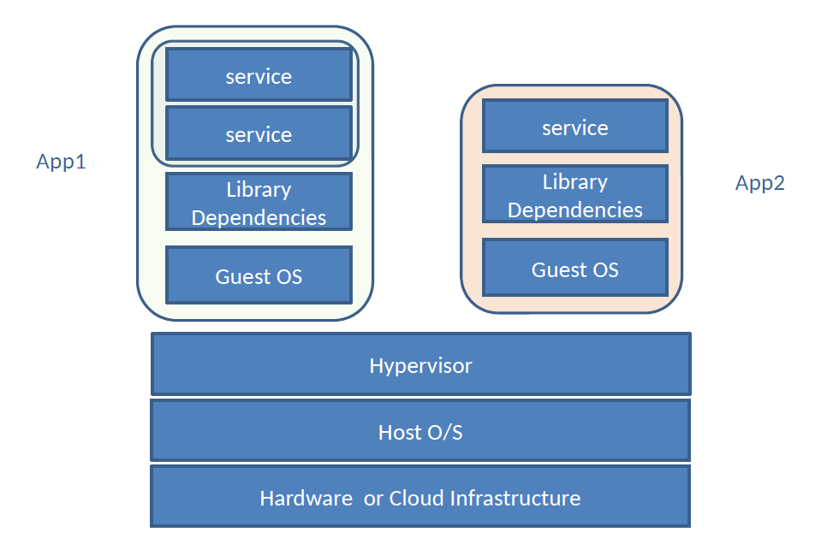
Typical VM architecture

Slide 7
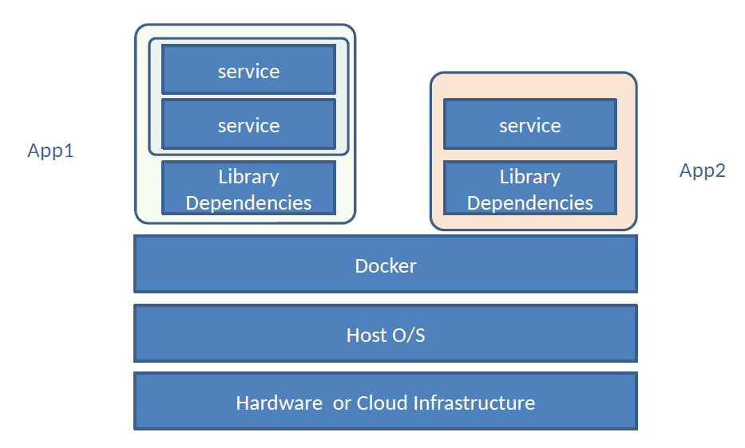
Docker architecture

Slide 8
Docker functionality
A programmer creates an application on a development machine
Packages all dependencies for the application (like libraries) into a ‘container’
Deploys the container into a hub
The container can be downloaded and deployed into any network or machine or on the cloud

Slide 9
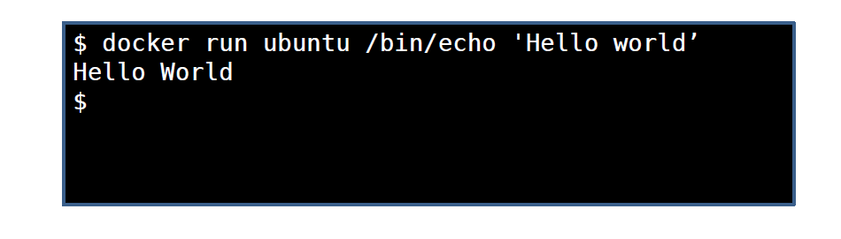
Hello World
docker run runs the container ubuntu which has to run the command /bin/echo with the argument ‘Hello World’
The container ubuntu is pulled from a hub

Slide 10
Docker tutorials
For installation and first steps, see here
For setting up your first web app, see here
We will follow both tutorials to build up confidence in working with docker
Then we will work on doing something simple
Pull the default ubuntu container from Docker Hub
Install Apache2 server on it and serve a static website from /var/www/ of the ubuntu container
Install ssh on the container, and get it to work
Ssh into the container from your local machine, make changes on the website, and verify that the changes are visible on the served page

Slide 11
Serving a web page with Apache
Install and run apache2 server
For help, see here
Put your html file in the /var/www/html folder
You should be able to access the file from your browser at
http://<docker box IP address>/filename.html
Be sure to set correct permissions for the /var/www/html folder with chmod
user-group-others
7 (rwx) for user, 6 (rw-) for group, and 5 (r-x) for others
Other configurations that make sense, e.g. 644

Slide 12
Web apps on Docker
Develop web app in your container
Test
Deploy on a server
Change
Test
Redeploy
Why Docker instead of local development and Github?

Slide 13
Scales well
If your application contains multiple containers
One for the server
One for the db
One for the cache
Build each container separately using separate Dockerfiles
Docker Compose files specify how the app is made from multiple containers
Can host on separate clusters of physical machines to improve latency of app
docker compose scale node=4

Slide 14
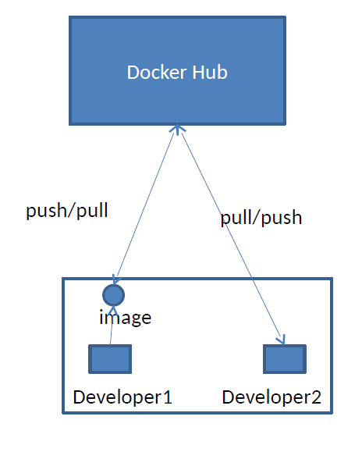
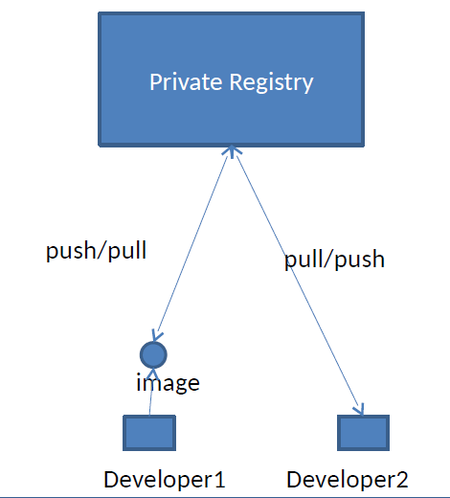
Multiple dev scenarios

Slide 15
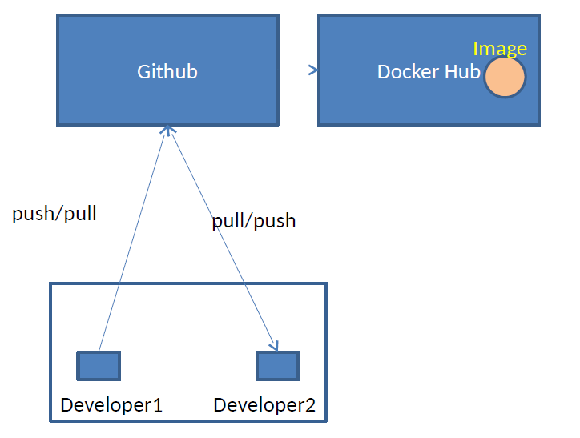
Flexibility in process cycle

Slide 16
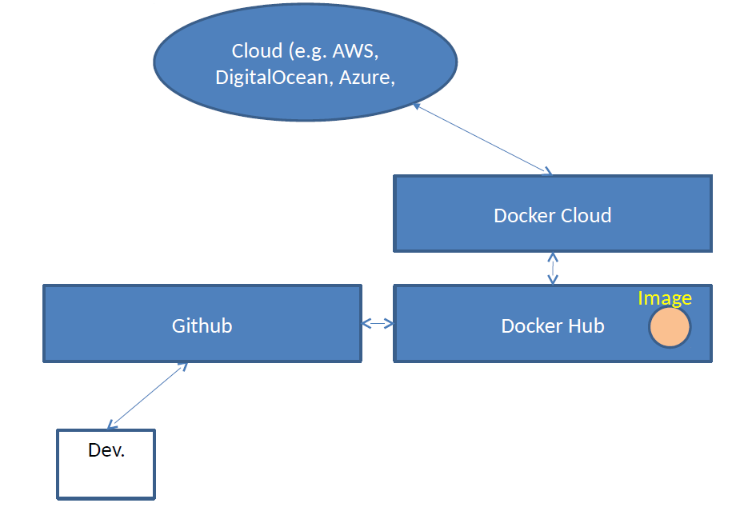
Cloud deployment

Slide 17
To do for the week after
Learn how to use Docker
How to run and stop containers
How to build new images and save them
How to remotely access your docker box securely
How to serve a web page from your docker box using Apache2 server

Slide 18
Reminder: this week
Demo (address book for cricketers)
Add data (25 points)
Name, team, batting average
If the name is duplicating a name already in the address book, prompt to replace old information with new
Search (25 points)
By name or team
Display all relevant records
Remove (25 points)
After search returns a record, offer the option to remove it
Scrape (25 points)
Scrape current Indian ODI players’ records from Cricinfo and populate the address book
Show the demo to me whenever you’re ready
Fine to finish it at home and come ready to demo

